Slide 1
Developing a Linux Loadable Kernel Module based rootkit from scratch
Soumyanil Biswas (@reveng007)

Slide 2

$id
Soumyanil Biswas aka reveng007
Junior Security Analyst @FireCompass
Wannabe RedTeamer/Malware Developer In
Windows Env.
Have CRTP
Recently Started a bit of Threat Hunting
For Developing knowledge of building
Detection Scripts!
Fan of BatMan and MMA :)

Slide 3
What are rootkit ?
A rootkit is a group of software tools used by an attacker to cover his or her tracks.
Rootkits can also contain software which allows the attacker to obtain root access and steal or remove files on a system. This works by using a vulnerable program to obtain root privileges as a regular user, called privilege escalation.
Mechanisms applied not limited!
This occurs by tricking this vulnerable application, or a person using the vulnerable application, to do something it shouldn’t (malicious stuff), ultimately resulting in root privileges.
Rootkits can also be kernel based. Once installed, they intercept legitimate Linux commands like, ls, dir, pwd, kill etc., to filter out those informations which are not intended to be displayed by those commands, such as the presence of files, folders, or processes.
LKM rootkit basically manipulates the normal Kernel behaviour in whatever way it wants it to work!

Slide 4
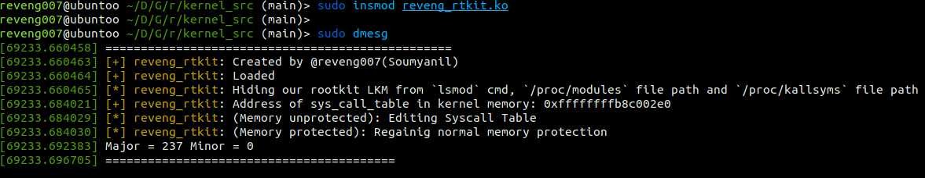
Introduction:
reveng_rtkit is a Linux Loadable Kernel module (aka LKM) based rootkit (ring-0), targeting Linux Kernel: 6.2.0-26-generic, 5.19.0-32-generic (also, 5.11.0-49-generic and 5.15.x) as it was only tested on it till now. It is capable of hiding itself, processes/implants, rmmod proof, ability to escalate privilege to root user without requiring any sudo password (once it is injected into the kernel), has the ability to bypass the infamous rkhunter anti-rootkit and chkrootkit (if processes are not hidden). This project is heavily inspired by Heroin by Runar Jensen and Diamorphine by Victor Ramos Mello, open-source LKM based rootkit projects. It is basically a post-exploitation tool with the intent to perform every task stealthily (without getting caught).

Slide 5
Syscall interception/ Hijacking method:
We will use, rather misuse system call to communicate between user-mode and kernel-mode and grab our ultimate cookie. This is the main/common thing for which an LKM based rootkit is famous. There are many methods to perform Syscall interception in Linux. Apart from all the methods available, I implemented the Syscall table hijacking technique to hijack the syscall and kallsyms_lookup_name() in order to perform the syscall hooking, so that we can execute our own set of custom made malicious functions.

Slide 6
2. IOCTL:
User-mode application will be created to communicate with LKM in the kernel via a character device file, which will already be registered by our LKM rootkit. As the User-mode application will only send command to LKM in the kernel, it will only perform IOCTL write to the already registered Character Device file and the LKM will perform IOCTL read from the registered Character Device file to read the command and compare those commands with the hardcoded commands which are present in LKM, if those commands satisfy the condition, LKM will show output/message on the Kernel Log. I also included the IOCTL write a feature to the LKM so that if we (attacker) want to change/ append some value to the registered Character Device Driver present in /dev directory named, etx_device externally, we will get to see the notification message being logged in the Kernel Log.

Slide 7
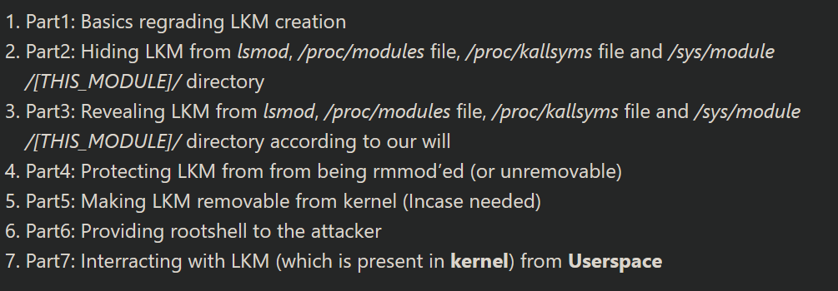
Steps I followed to create this rootkit:

Slide 8
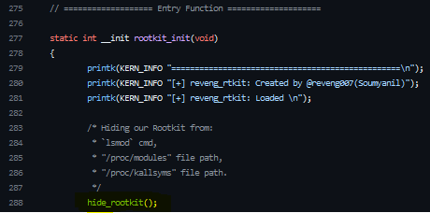
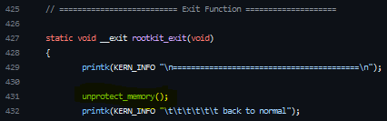
Part1: Basics regarding LKM (Dynamic Module) creation:
Unlike User Mode C Programming, in kernel mode, there are two main functions.
First one: initialize functions (Entry Function) after getting injected into Kernel.
Last one: To remove/ clean configurations that is done to kernel (Exit Function) after ejection of LKM out from Kernel.

Slide 9
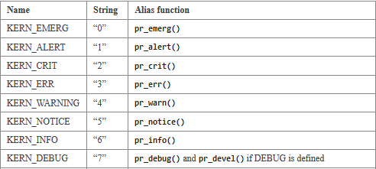
3. “KERN_INFO” inside printk ?
4. These are log levels attached to print in Kernel .
There are total eight of them.
In my rootkit, I only used KERN_INFO (or pr_info (macro version)) and KERN_ERR (or pr_err (macro version)).
5. The whole point of using this, is specifying the importance of a messages to be printed.
6. The condition is: Log level (or default log level) < Console log level = Shows Output to console
Current console log level
Default log level
7. Below 4 => output to console (hardware terminal)
(ctrl+alt+f2/f3)
Else => logged into kernel log file
(can be called by dmesg)
Link: https://www.kernel.org/doc/html/latest/core-api/printk-basics.html

Slide 10

8. LKM Handling:
Injecting a rootkit with: insmod <rootkit_name>.ko
To see the log message: dmesg
To eject rootkit out: rmmod <rootkit_name>
9. Several methods to see injected LKM in kernel:
[ Rootkit implementation started, So Buckle Up :) ]
I. lsmod
II. /proc/modules file (procfs)
III. /proc/kallsyms file (procfs)
IV. /sys/module/[THIS_MODULE]/ directory (sysfs)

Slide 11
Steps I followed to create this rootkit:

Slide 12
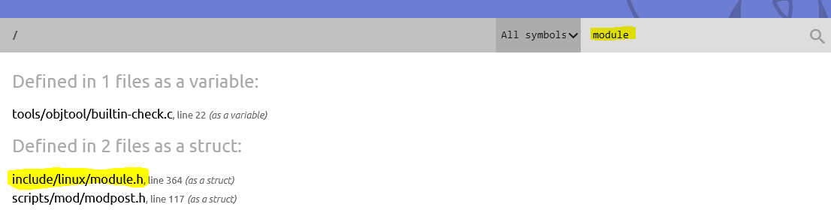
Part2: Let’s Hide!:
LKM is inserted into the kernel => a corresponding element and kernel object is added to the responsible linked list.
If that element and kobject is removed => Work is DONE!
Methodology to find out correct kernel api structure:
I. LKM is a module, we can simply search via “module”
Link: Linux kernel API documentation: https://elixir.bootlin.com/linux/v5.15/A/ident/module

Slide 13
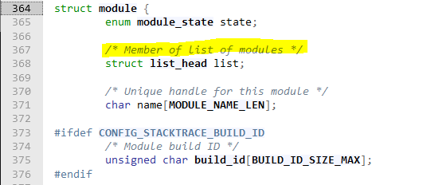
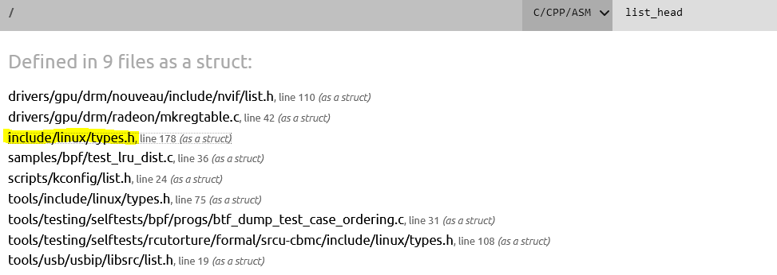
II. After clicking the module.h file => module struct => list_head struct
III. list_head ( Click ) => redirected to here:
(Most Common directory which has almost all essential libraries: include/linux )

Slide 14

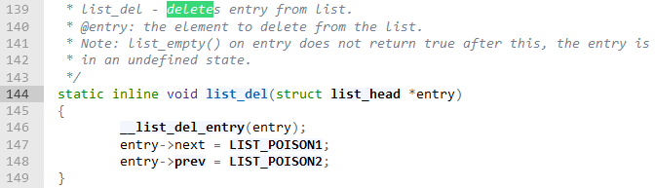
IV. Got this structure:
V. Remove our LKM element from this list => DONE!
VI. How to remove that?
[ Previously, in kernel 5.11,
the responsible function: list_del() and list_head()
=> in list.h (Got list_del() just by searching for “delete” keyword)
But for kernel 5.15, list_head() in types.h, but list_del() is in list.h file ]

Slide 15

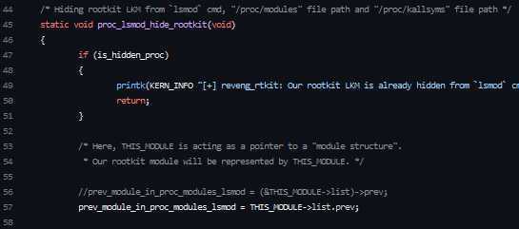
VII. To call list_del(struct list_head *entry) => pass: address of our current module element.
Address of currently loaded module element from list_head list
VIII. Before removing, Storing location of LKM element: (To undo our did after removal of LKM) => OPSEC safe!
Link: https://github.com/reveng007/reveng_rtkit/blob/main/kernel_src/include/hide_show_helper.h#L78 https://github.com/reveng007/reveng_rtkit/blob/main/kernel_src/include/hide_show_helper.h#L37

Slide 16

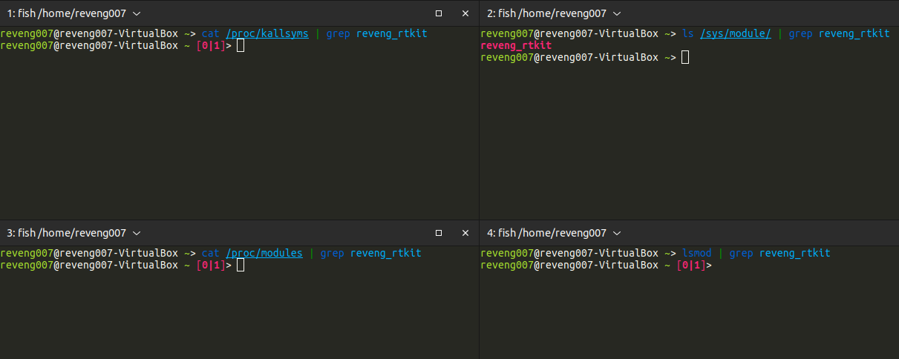
IX. Removing:
Project link: https://github.com/reveng007/reveng_rtkit/blob/main/kernel_src/include/hide_show_helper.h#L78

Slide 17
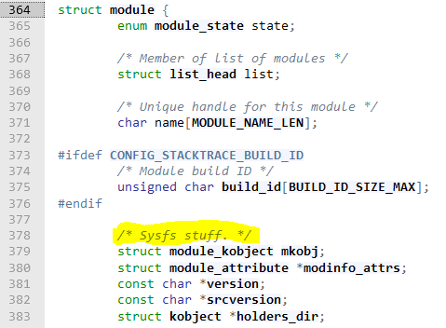
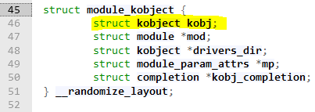
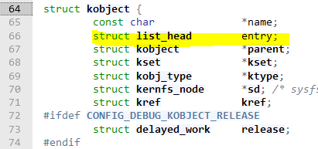
We can see that /sys/modules directory => Not HIDDEN!
Cause to Hide that => Remove responsible corresponding KObject from list.
Methodology to find out correct kernel api structure:
I. Searched: module (again! As LKM is a module :))
II. Clicked: module_kobject => attractive!
III. Got This:
IV. Again, kobject :) => guess what ? Clicked

Slide 18
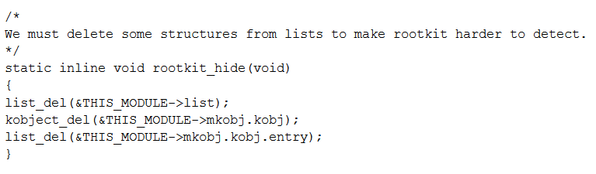
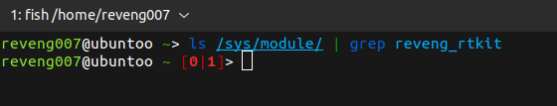
V. Whole PATH: mkobj.kobj.entry
VI. Now, How to delete this kobject?
Paper by Ormi:
And Boom!
Already Done!
Let’s implement this
This have a caveat! Gonna explain why in revealing LKM section
link: https://theswissbay.ch/pdf/Whitepaper/Writing%20a%20simple%20rootkit%20for%20Linux%20-%20Ormi.pdf

Slide 19
Steps I followed to create this rootkit:

Slide 20
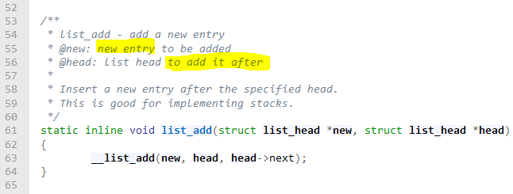

Part3: Let’s Reveal!:
But Why? => to Remove LKM from kernel
=> Add: corresponding elements and kobjects back to responsible list.
Just Like list_del() in list.h, there was another function named as list_add()
Args: I. &THIS_MODULE->list II. the variable we stored earlier => prev_module_in_proc_modules_lsmod
link: https://github.com/reveng007/reveng_rtkit/blob/main/kernel_src/include/hide_show_helper.h#L149

Slide 21

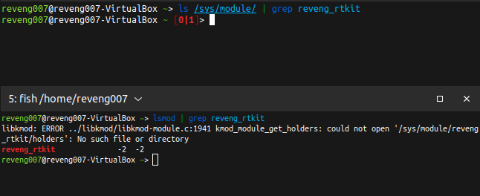
4. Output:
But…..
Let’s add kobject => Solve this?

Slide 22

5. Here is the Problem! I tried these functions:
None of them worked!
6. So, /sys/module/ directory
=> Easy Win for BlueTeamers to Check any suspicious folders (meaning LKM ).

Slide 23
Steps I followed to create this rootkit:

Slide 24
Part4: Let’s Protect our Creation! (rmmod Proof):
Use: try_module_get() kernel API
Success? => Can’t be removed! => Alternative in demo video :)
link: https://github.com/nurupo/rootkit/blob/master/rootkit.c#L617

Slide 25
Steps I followed to create this rootkit:

Slide 26

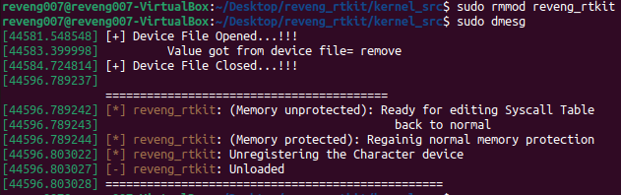
Part5: Making our Creation Removable:
Use: module_put() kernel API
Unloaded!
link: https://github.com/nurupo/rootkit/blob/master/rootkit.c#L628

Slide 27
Steps I followed to create this rootkit:

Slide 28


According to Torvald’s documentation,
And setting Altered Creds:
Part6: Getting a rootshell:
link: https://xcellerator.github.io/posts/linux_rootkits_03/#changing-credentials https://github.com/torvalds/linux/blob/master/Documentation/security/credentials.rst#altering-credentials

Slide 29
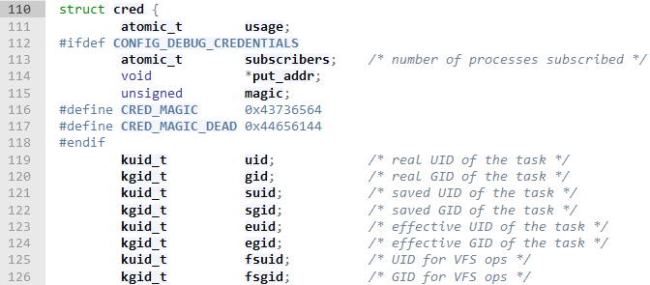
2. What to Alter ?
link: https://elixir.bootlin.com/linux/v5.15/source/include/linux/cred.h#L110

Slide 30
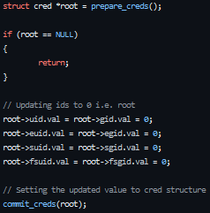
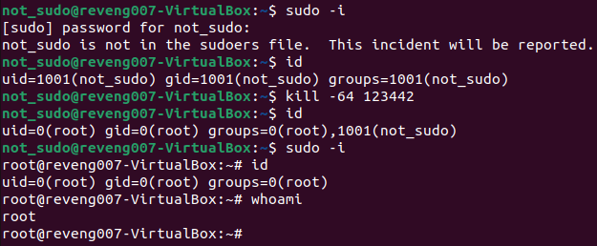
3. Final Code:
4. Workings:
link: https://github.com/reveng007/reveng_rtkit/blob/7ae65c6edaeab1b9bea0e8aef29803a6e1f48135/kernel_src/include/hook_syscall_helper.h#L237

Slide 31
Steps I followed to create this rootkit:

Slide 32
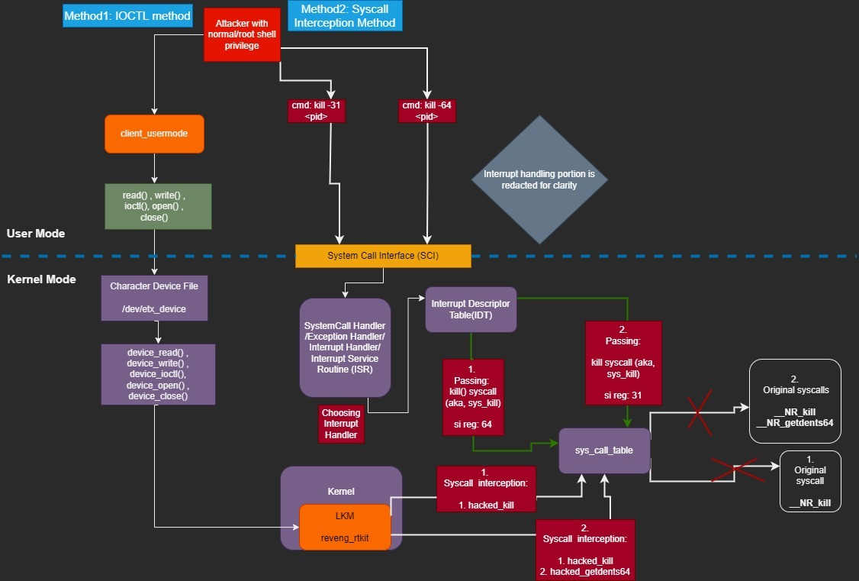
Till now, We all came to know how to do stuff in kernel using LKM rootkit.
How to Control Injected LKM?
Control from user-mode(terminal) to the LKM in kernel:
I. One way is a direct conversation via syscall
II. Another way is not so direct, via IOCTL(Input Output Control).
Part7: Interacting with LKM in kernel from User Space:
link: https://github.com/reveng007/reveng_rtkit/blob/main/reveng_rtkit_mechanism.jpeg?raw=true

Slide 33
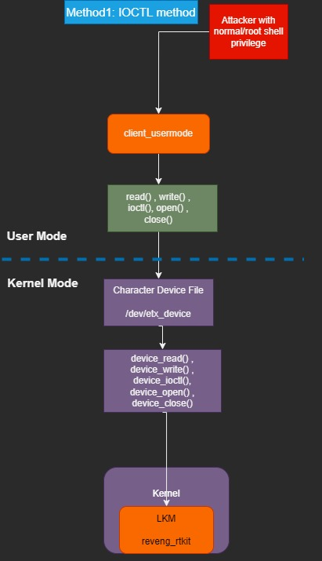
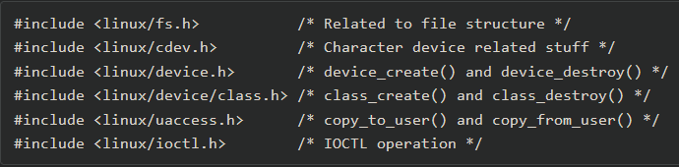
The libraries that we would be using are these:
In this Scenario : 2 programs are required
I. client_usermode.c To write to Char Device File
II. another part in LKM Called Device Driver.
LKM Injected Char Device File registered
How?
Part7.1: IOCTL Control:
link:
https://github.com/Embetronicx/Tutorials/blob/master/Linux/Device_Driver/IOCTL/driver.c

Slide 34
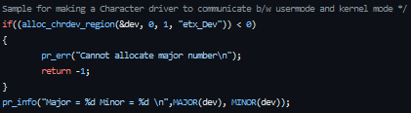

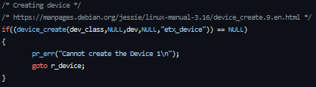
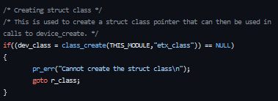


3. Generating dual nature: (LKM as Char Device Driver):
4. Registering and adding Char Device file:
link: https://github.com/reveng007/reveng_rtkit/blob/7ae65c6edaeab1b9bea0e8aef29803a6e1f48135/kernel_src/reveng_rtkit.c#L322

Slide 35
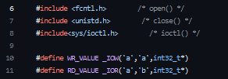



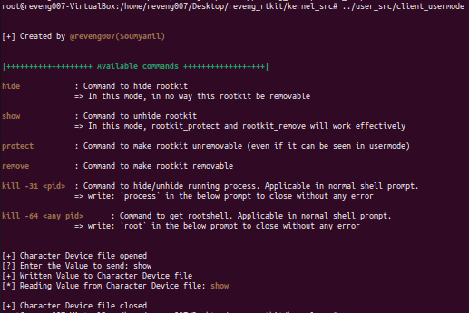
5. To Write to the Char Device File: (From User Mode) [SNIP : from User Mode C program, client_usermode.c]
6. How does it look?

Slide 36

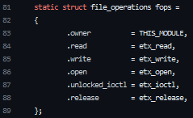
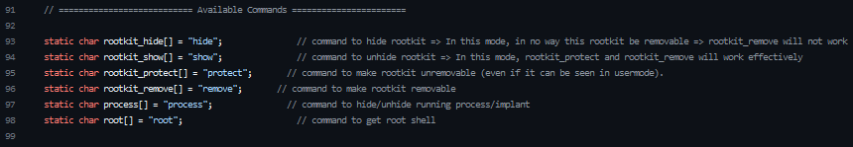
7. How to read from Char Device File (From kernel Mode) ?
Essential Structure interacting with Device Files by Device Drivers.
To read from Char Device File and Compare:
Just similar to User Mode C macro

Slide 37
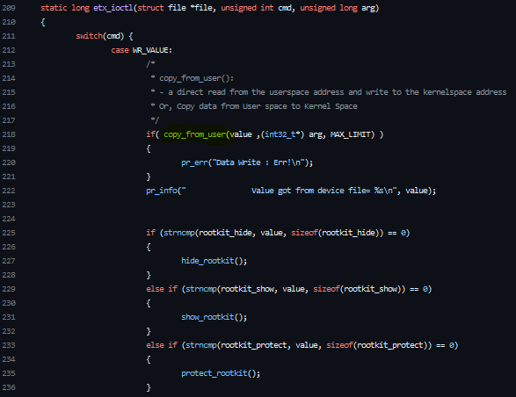

7. Char Device File Clean Up soon after removal of our LKM
8. Now the Main Part :)

Slide 38
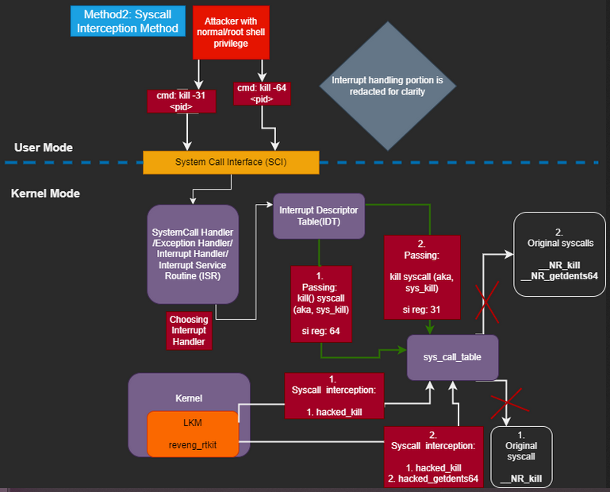
Part7.2: Control via Syscall Interception:

Slide 39
System Call is a way for programs to interact with the operating system.
2. Let’s abuse/intercept Syscalls Many ways! Syscall table hijacking technique
3. Syscall table hijacking technique Many ways! kallsyms_lookup_name()
1st Step: Get address of Syscall table via symbol
Manual Method:
2. Programmatic method using Syscall (simply functions): -> PTO
link:
https://foxtrot-sq.medium.com/linux-rootkits-multiple-ways-to-hook-syscall-s-7001cc02a1e6
https://infosecwriteups.com/linux-kernel-module-rootkit-syscall-table-hijacking-8f1bc0bd099c

Slide 40


3. kallsyms_lookup_name() Find sys_call_table symbol “/proc/kallsyms” file
4. CaVeat :
5. Making Custom kallsyms_lookup_name() :)
I. Kprobe: To collect dynamically loaded kernel module symbols .
II. In kprobe structure:
Our target!
link:
https://github.com/xcellerator/linux_kernel_hacking/issues/3
https://ish-ar.io/kprobes-in-a-nutshell/
https://elixir.bootlin.com/linux/v5.15/source/include/linux/kprobes.h#L60

Slide 41

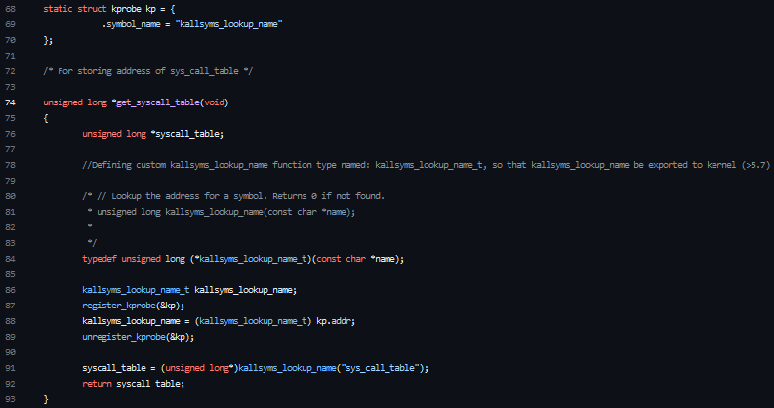
Defining Custom Data Type
link:
https://elixir.bootlin.com/linux/v5.15/source/include/linux/kprobes.h#L60

Slide 42
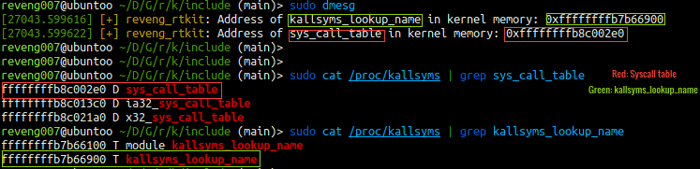
6. Working ? => Sensitive Symbols Exported On Kernel Version > 5.7 :)
2nd Step: Modifying SysCall Table Permission
WP (write protection) flag in the control register (or cr0 reg) => Disable!
Reason:
Cr0 reg = Processor register controls the behavior of the CPU
If WP flag value changed to 0 => We can Edit read-only sections like SysCall Table
Let’s do it!

Slide 43
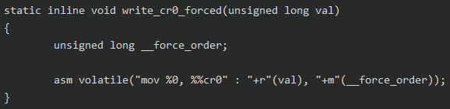
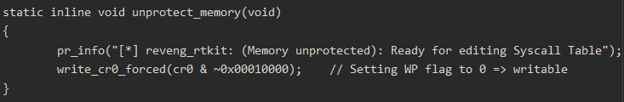
2. Thanks to patchwork.kernel.org:
Before Modifying WP flag by forcing instruction serialization:
Calling this:
If not Used => Modifying WP flag -> Causes Error.
3. Now, Updating -> WP flag -> read-only sections Writable -> SysCall Table (Ready!)
Link:
https://patchwork.kernel.org/project/linux-hardening/patch/20190226233647.28547-2-keescook@chromium.org/
https://github.com/reveng007/reveng_rtkit/blob/055b7dce57cf1317f13fb3bd141e21c3ec82c5dc/kernel_src/include/hook_syscall_helper.h#L323

Slide 44

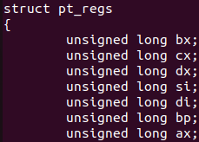
3rd Step:
Performing the actual hooking: __NR_kill (name of kill syscall (or sys_kill) in sys_call_table) => To Gain root access
Target: Redirect Original Syscall “__NR_kill” to execute our own malicious syscall/function.
I. Which Syscall? sys_kill ( Called by a userspace tool -> kill )
=> __NR_kill
II. But How ?
Theory:
Args passed from User Mode stored in registers.
B. Those registers stored in a struct called “pt_regs”:
link:
https://github.com/torvalds/linux/blob/15bc20c6af4ceee97a1f90b43c0e386643c071b4/arch/x86/include/asm/ptrace.h#L12

Slide 45


III. But which register ?
Syscalls64 to the rescue!
automagically detects current process id
Syntax of kill: kill $signal <pid>
IV. In our scenario,
IMP: rsi -> passed args = signal = 64 (anything can be used!) => For PrivEsc!
Let’s see the code =>
Link: https://syscalls64.paolostivanin.com/

Slide 46

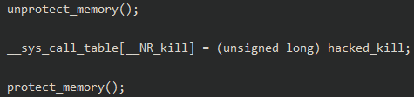
Creating custom function type => Storing Original syscall => __NR_kill
Creating a BackUp function and storing original syscall, i.e., __NR_kill
Backing Up => DONE!
Diverge to our Malicious function:
Unprotecting syscall Table memory
Diverging to our Malicious Function
Protecting Syscall Table memory
Let’s see the malicious code!
link:
https://github.com/reveng007/reveng_rtkit/blob/055b7dce57cf1317f13fb3bd141e21c3ec82c5dc/kernel_src/include/hook_syscall_helper.h#L42

Slide 47
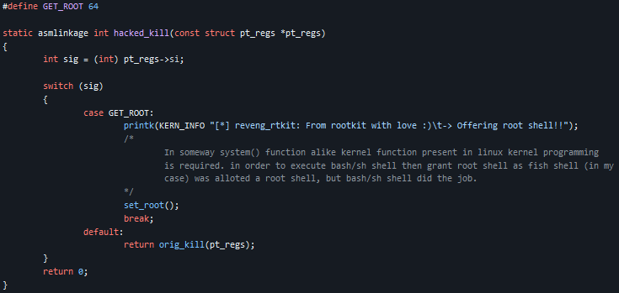
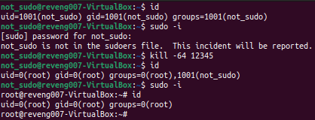
Workings:
If 64 => privEsc to root
Else returning original syscall
link:
https://github.com/reveng007/reveng_rtkit/blob/main/kernel_src/include/hook_syscall_helper.h#L279

Slide 48

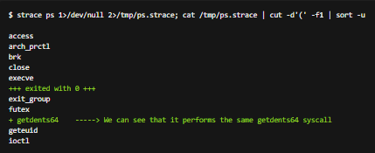
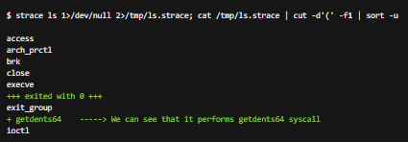
2. Performing the actual hooking: __NR_getdents64 => To Hide processes and /proc/<pid>
Target: Redirect Original Syscall “__NR_getdents64” to execute our own malicious syscall/function.
I. Which Syscall? sys_getdents64 ( Called by a userspace tool -> ls and ps )
=> __NR_getdents64
II. strace output: (Why? ls and ps )
ps => ls on “/proc/”
link:
https://elixir.bootlin.com/linux/v5.11/source/arch/arm64/include/asm/unistd32.h#L87

Slide 49
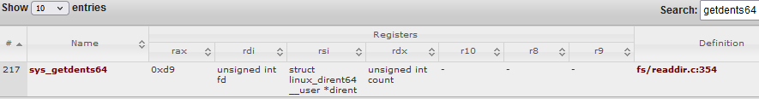

III. Double syscall interception:
i. kill syscall:
Hide pid => signal 32 (pid from “rdi” register) [Same as Before] => Got pid to Hide
ii. getdents64 syscall:
Hide “/proc/pid” file =>
Let’s see the code!
pid
Signal

Slide 50
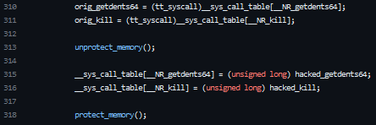
Creating function and storing original syscalls, i.e., __NR_kill and __NR_getdents64
Now:
“hacked_getdents64” ?
“hacked_kill”?

Slide 51


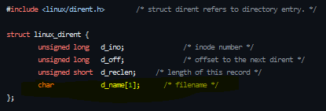


hacked_getdents64:
Pid Name = File Name
err = error code = -ve in Linux Kernel
Returns size of the process name, corresponding to pid, user passed

Slide 52


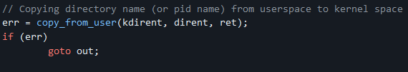
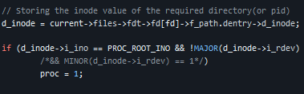


Creating a variable to Store process name in Kernel Mode:
Syntax: kill -32 <pid num.>
Checking the presence of Inode
link:
https://elixir.bootlin.com/linux/v5.15/source/include/linux/slab.h#L719
https://elixir.bootlin.com/linux/v5.15/source/include/linux/gfp.h#L324
Presence of /proc/ directory

Slide 53
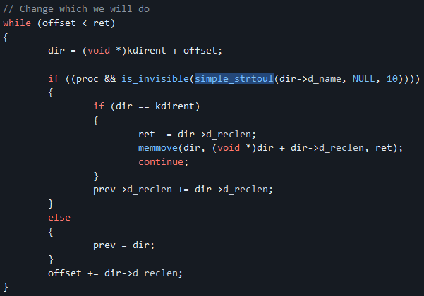




Iterate through directory entries: to HIDE:
Thanks to Diamorphine project for this snippet!
Basically, what it does is…

Slide 54



tasks for corresponding pid => Invisible!
Top Level structure for defining a task/process
Starting point for Kernel Mode process/task manipulation
If not then Hides it
via
hacked_kill()
mal. function
Bitwise Operation Checks Status:
Process Invisibility

Slide 55


Last Malicious function => hacked_kill
Storing pid
Storing signal
link:
https://unix.stackexchange.com/questions/258955/what-does-esrch-mean

Slide 56

Working:

Slide 57

Making it Reboot Persistent (Manual Method):
Leverage initramfs => rootkit load ups automatically at BOOT time.

Slide 58


Just after reboot:
Snipping some output…
Loaded Automatically!!

Slide 59


Rkhunter Scan result:
Scan Log file: /home/reveng007/typescript
link:
https://unix.stackexchange.com/questions/373718/rkhunter-gives-me-a-warning-for-usr-bin-lwp-request-what-should-i-do-debi

Slide 60

My rootkit features:

Slide 61
Demo Time:

Slide 62


Limitations:
This LKM based rootkit can only be used in those Linux OSs, which don't have these two protections:
Secure Boot
Adding a grub parameter to "/etc/default/grub" file. This thing was pointed out to me by Artem Baranov and this link was shared to me, on my linkedin post, by Victor Sergeev, for further research.
Steps:
I. Updating /etc/default/grub with:
II. Generating a new configuration file after updation:
III. After Reboot…

Slide 63


Detection!
Much much thanks to Thomas Strömberg for writing a detection blog on my tool! :)
Ran osqueryi
I. Detecting hidden pids (script: pid-hidden-by-rootkit.sql , mode = .mode line)
Running osqueryi: sudo osqueryi
After pasting the script:
Blog link:
https://unfinished.bike/diy-linux-kernel-rootkit-detection

Slide 64


II. Detecting unusual kernel taints (Script: kernel-taint.sh)
NOTE: As I tested in Vbox => vboxguest LKM somekind!
But it worked, according to the analysis done by Thomas Strömberg .
Can also be detected by : Osqueryi Sql Script: unusually-tainted-kernel-linux.sql

Slide 65

III. Detecting unusual /dev entries (Script: unexpected-device.sql, mode: .mode line)
After running osqueryi and running the script:
Another rootkit detection paper by SANS:
Linux kernel rootkits: protecting the system’s “Ring-Zero”
Can be Explored, too!

Slide 66
Updation That Can be Made:
Hiding process files completely. Our hidden process file can be accessed to open/read. If someone does, ls <filename>, they can easily open them.
Successfully able to hide and reveal our LKM module from /sys/module/ directory using syscall interception, in order to deceive usermode programs.
Adding system() C function alike function in Linux Kernel programming, in order to open a new bash/sh prompt.
Adding Linux Kernel Sockets.
Surviving system reboot (automagically).
Bypassing chkrootkit antirootkit

Slide 67
Honourable Mentions:
kurogai/100-redteam-project :
got displayed in the publicly available top 100 Red Teaming tools.
milabs/awesome-linux-rootkits:
got displayed in the publicly available rootkit list, named, awesome-linux-rootkits list, which has over 1k stars and 100 forks.
Selected by BSides St Pete 2022, Florida to be presented - link.
Selected by BSides Prishtina 2023, Kosovo to be presented - link.
BlackHat, USA - twitter-thread

Slide 68
Links to project repo and blog post:
Project: https://github.com/reveng007/reveng_rtkit
Blog post: https://reveng007.github.io/blog/2022/03/08/reveng_rkit_detailed.html
Kernel Space rootkits Attack/Detection Hands-On : https://conference.hitb.org/hitbsecconf2023hkt/product/practical-linux-rootkits-hitb2023hkt/ (HITBSecConf 2023 - Phuket) by LESZEK MIŚ aka @cr0nym

Slide 69
References:
https://github.com/pentesteracademy/linux-rootkits-red-blue-teams
Rootkit features: https://github.com/R3x/linux-rootkits
Simple LKM rootkit: https://theswissbay.ch/pdf/Whitepaper/Writing%20a%20simple%20rootkit%20for%20Linux%20-%20Ormi.pdf
IOCTL: https://github.com/Embetronicx/Tutorials/tree/master/Linux/Device_Driver/IOCTL
https://infosecwriteups.com/linux-kernel-module-rootkit-syscall-table-hijacking-8f1bc0bd099c
LKM HACKING: https://web.archive.org/web/20140701183221/https://www.thc.org/papers/LKM_HACKING.html
Hide Files and Processes: i. https://web.archive.org/web/20140701183221/https://www.thc.org/papers/LKM_HACKING.html#II.2.1. ii. https://web.archive.org/web/20140701183221/https://www.thc.org/papers/LKM_HACKING.html#II.5. iii. https://jm33.me/linux-rootkit-for-fun-and-profit-0x02-lkm-hide-filesprocs.html
Get Rootshell: https://xcellerator.github.io/posts/linux_rootkits_03/
kobject: https://www.win.tue.nl/~aeb/linux/lk/lk-13.html
https://sysprog21.github.io/lkmpg/
https://ish-ar.io/kprobes-in-a-nutshell/
Editing cr0 register: https://hadfiabdelmoumene.medium.com/change-value-of-wp-bit-in-cr0-when-cr0-is-panned-45a12c7e8411

Slide 70
QnA

